Slide 1
The queue data structure is a sequential collection of elements that follows the principle of first in first out(FIFO)
The first element into the queue is the first element to be removed.
A queue of people. People enter the queue at one end(rear/tail) and leave the queue from the other end ( front/end).
Queue is an abstract data type. It is defined by the its behaviors rather tan being a mathematical model.
The Queue data structure supports two main operations
Enqueue, which adds an element to the rear/tail of the collection
Dequeue, which removes an element from the front/end of the collection
The queue usage
Printer, CPU task scheduling, callback in JavaScript runtime

Slide 2
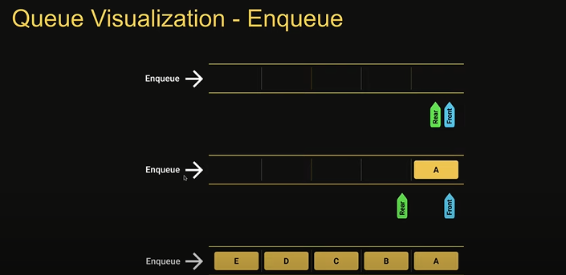
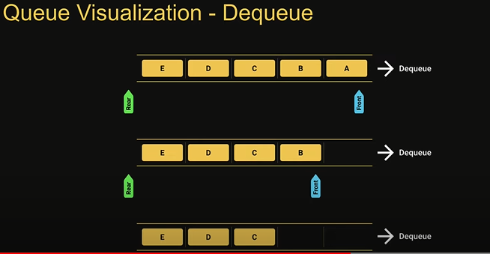
Queue Implementation
Enqueue (element) =- add an element to the queue
Dequeue () – remove the oldest element from the queue
Peek()- get the value of the element at the front of the quque without removing it
isEmpty() - check if the queue is empty
Size() – get the number of elements in the queue
Print() – visualize the elements in the queue

Slide 3
The size of the queue is fixed and a single block of memory is used as if the first element is connected to the last element.
Also referred to as circular buffer or ring buffer and follows the FIFO principle
A circular queue will reuse the empty block created during the dequeuer operation
when working with queues of fixed maximum size, a circular queue is a great implementation choice
The circular queue data structure supports two main operations
Enqueue, which adds an element to rear/tail of the collection
Dequeue, which removes an element from the front/head of the collection.
Circular Queue usage – Clock, streaming data, traffic lights.

Slide 4
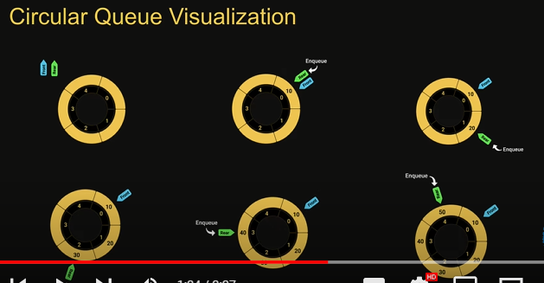
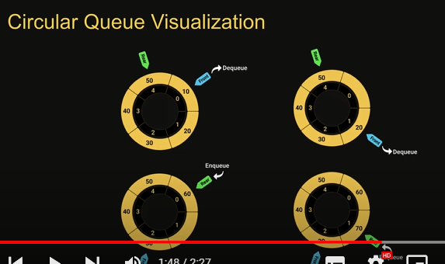
Queue Implementation
Enqueue (element) =- add an element to the queue
Dequeue () – remove the oldest element from the queue
isFull()- check if the queue is full
isEmpty() - check if the queue is empty
Peek()- get the value of the element at the front of the queue without removing it
Size() – get the number of elements in the queue
Print() – visualize the elements in the queue

